Slide 1

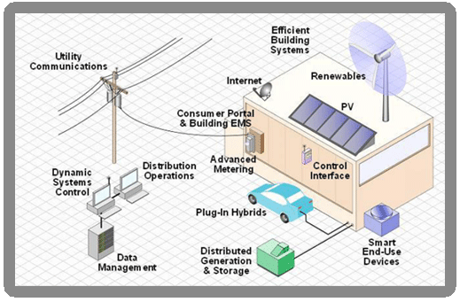
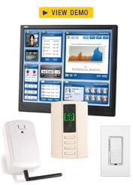
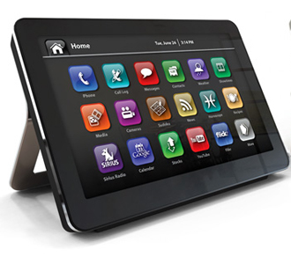
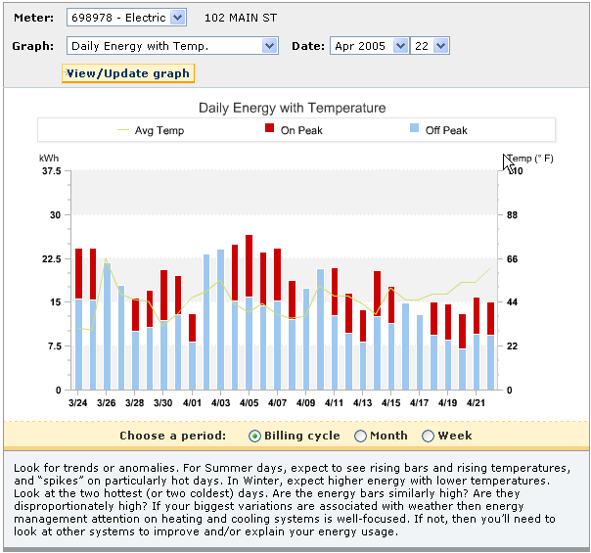
Information-enabled Energy Efficiency
Harvey Michaels, Lecturer/ Efficiency Strategy Research Director
Massachusetts Institute of Technology
June 18, 2010 Energy Roundtable Efficiency panel
hgm@mit.edu

Slide 2
80% below 1990 means:
Reduce US Carbon pp from 5.5 tons/yr to < 1 ton/yr
ENORMOUS EFFORT:
Capture all carbon from all coal plants (to date 0).
Triple coal and gas plants, also with all carbon captured.
2/3 of all cars/trucks all-electric, rest adv. biofuels.
In units of 1000 MW (a typical nuke) by 2050 we need:
  1200 wind (last year 8)
  1400 solar (last year .3)
  500 nuclear (last 20 years 0)
LAY-UP:
Improve energy efficiency by 3% per year.

Slide 3

How will we Enable Energy Efficiency?
US Buildings consume 71% of all electricity, 55% of all natural gas
30% efficiency achievable by 2030 with 3 Deployment options:
  Public funding models, incl. utilities: carrots
  Codes and Standards: sticks
  Data and intelligence-driven : information
  Transforming the nation’s consumers: good energy decisions (ie lower discount rates) change everything.

Slide 4
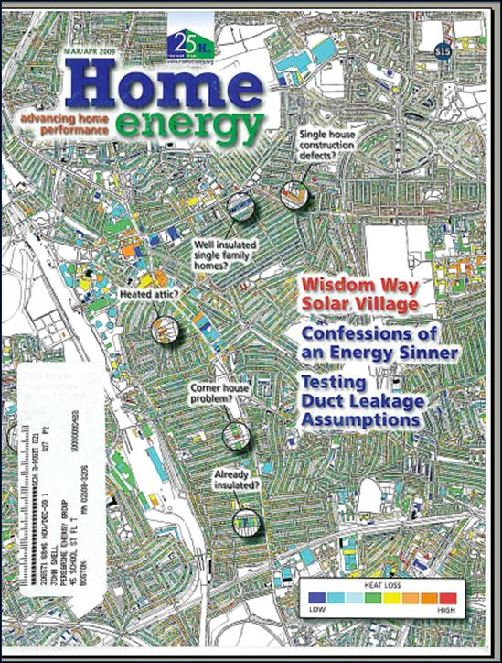
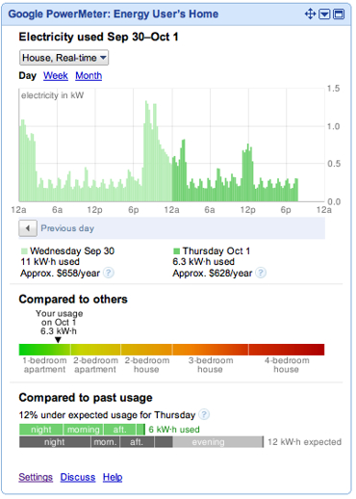
Smart Grid/AMI Granular Energy Data:
- energy diagnostics, feedback, control
Behavior impacts of smart grid-based information options may be as high as 30%:
Daily
End-use
Carbon Footprint?
Collective Action?
Fault-detection
Thematic Control – make me green
Control Precision
Adaptive Control Strategies

Slide 5
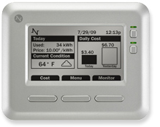
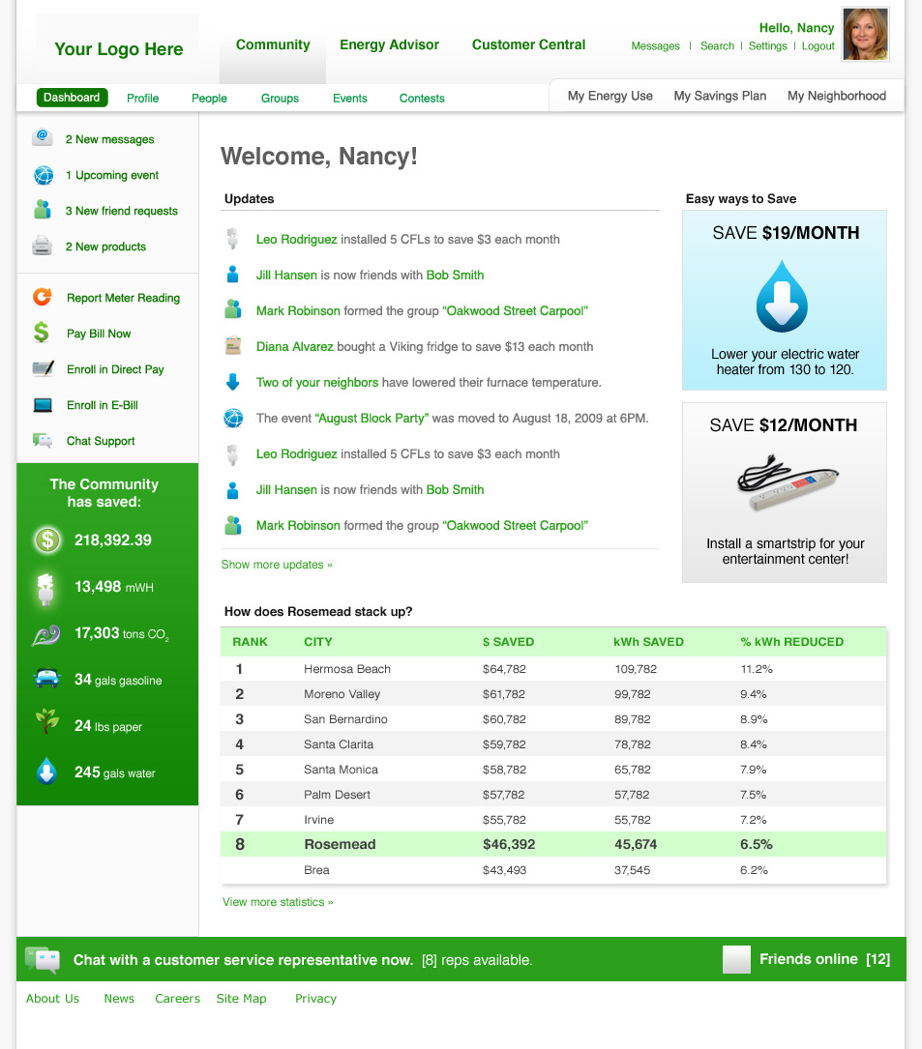
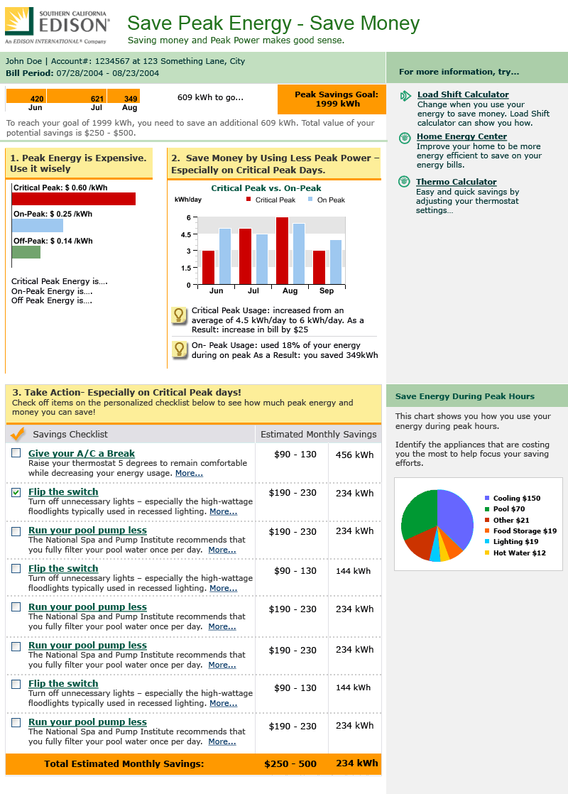
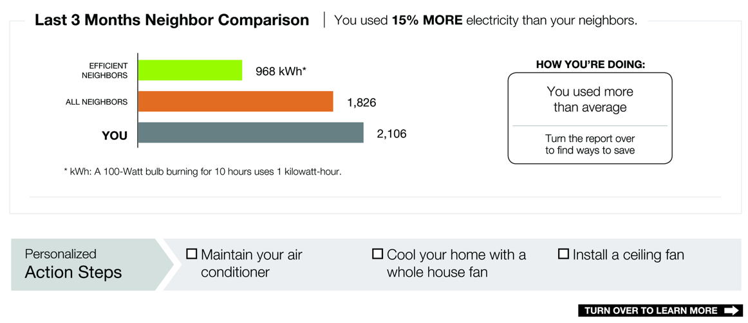
Only at the very beginning of adding inference/diagnostics to the Energy Internet

Slide 6
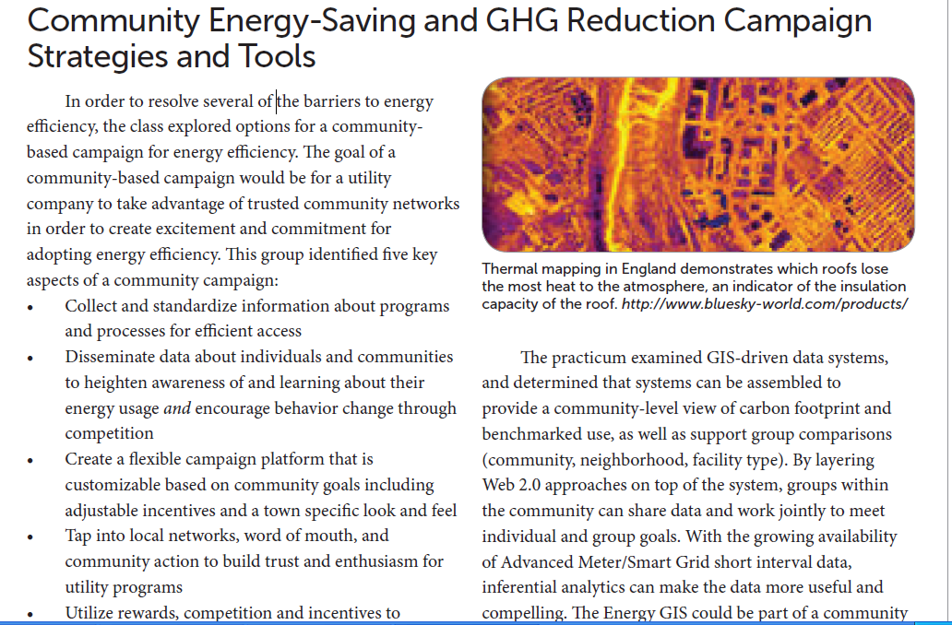
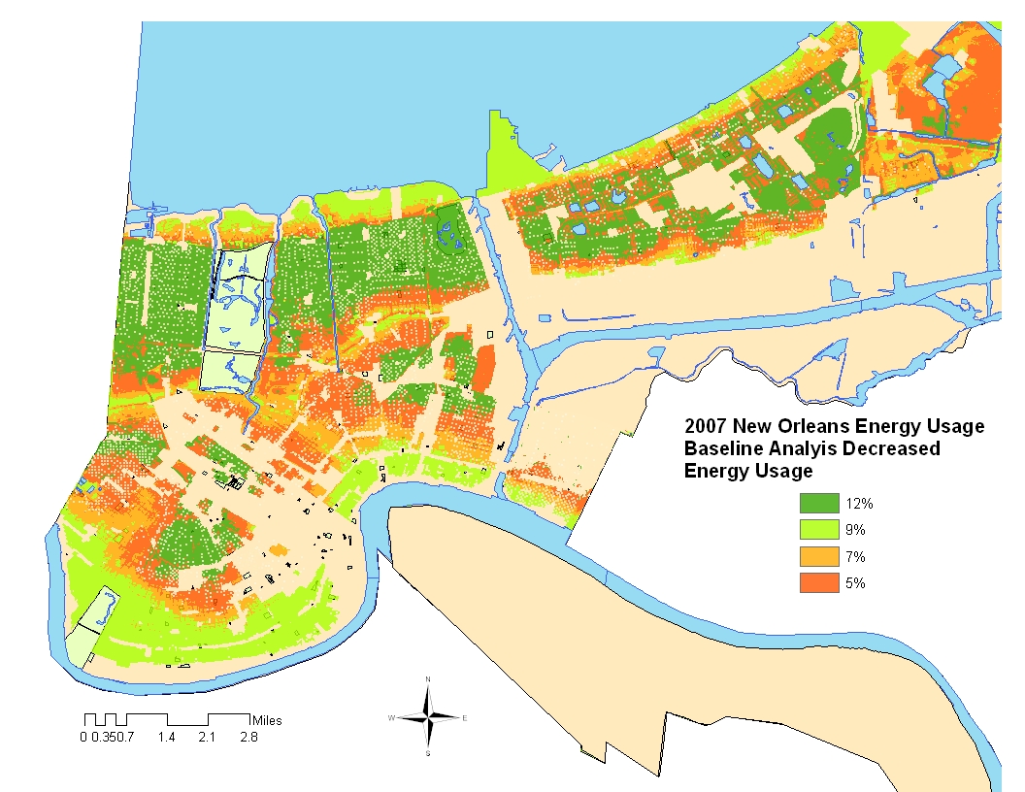
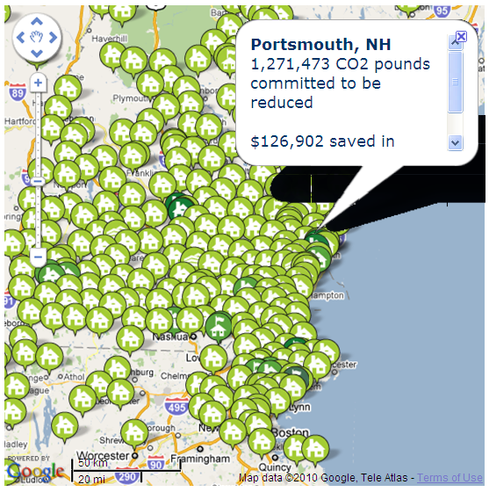

Slide 7
Meta-Review of Utility Feedback Programs
  Savings Results by Program Type
  Erhardt-Martinez, Donnelly, & Laitner 2010 (Forthcoming)
Opt in
Indiv.
(Total)
6.8%
(0.5%)
11.0%
(0.85%)
7.0%
(0.55%)
14.0%
(1.15%)
Opt Out
Indiv.
(Total)
5.6%
(4.5%)
7.0%
(5.65%)
14.0%
(11.25%)
Notes:
But, we can build on these findings. For instance, we know that utility feedback programs have predominantly focused on technology approaches, forgetting the individual and group behavior approaches.

Slide 8
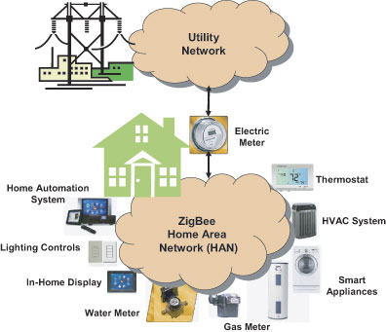
Consumer-responsive Architecture =
Providing consumers with energy diagnostics, feedback, control
refers to systems for optimizing consumers’ end-use needs (especially air conditioning, heat, hot water)
based on weather, schedules, and time differentiated costs.
Time-differentiated rates are more fair, and some would argue inevitable.
Customer Responsive Systems work 24/7,
providing efficiency as well as peak demand response.

Slide 9

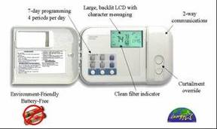
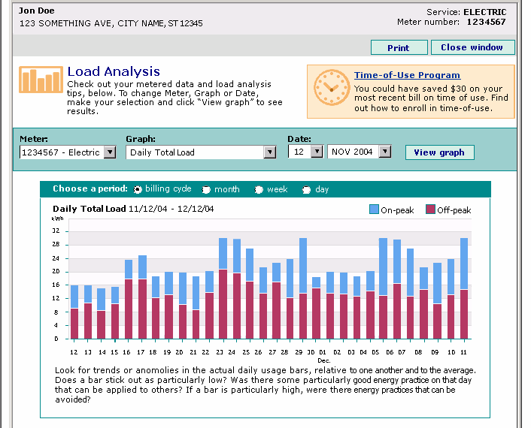


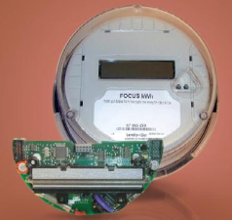

Consumer-Controlled, Public Network Architecture:
Utility’s Web Workspace
Device Workspace
Consumer-side
MDM
CRM
Utility-side

Slide 10
Key Hypothesis:
Utilities create the enabling conditions for market-based systems
To accomplish this, utilities, regulators should focus on:
  consumer-centric architectures for appliance control,
  Open and public architecture for AMI communication,
  Encouraging a broad ecosystem of content providers, including utilities.
2013 – How will efficiency look – when the politics change?
Smart meters and dynamic pricing – will we move forward?
The nation’s consumers – will we innovate, educate, and support good energy decisions? (ie lower discount rates)
We can do this – but can we do it in time?

